Slide 1



Understanding & Debugging Memory Leaks in Node.js Applications
Ali Ijaz Sheikh, Google Inc.
@ofrobots

Slide 2
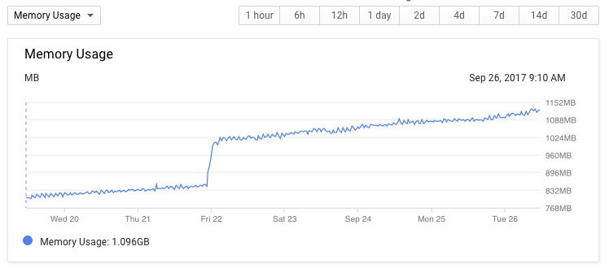
A picture is worth a thousand words

Slide 3
Memory leak: … when a computer program incorrectly manages memory allocations in such a way that memory that is no longer needed is not released. – wikipedia

Slide 4
Wasn't Garbage Collection supposed to solve this?

Slide 5

GC can only collect what it knows not to be in use.
"Objects that are reachable from roots are not garbage."

Slide 6
Avoiding Memory Leaks
Don't write any code yourself
Don't use code from anyone else
Avoid computers completely
…

Slide 7
Understanding Leaks

Slide 8
Garbage allocated on each request
Nothing holds onto the garbage
No leaks
app.get('/', (req, res) => {
const garbage = new Array(100000);
res.status(200).send(`hello world!`);
});

Slide 9
Each request now holds onto garbage
Requests are short lived
Not a leaks.
app.get('/', (req, res) => {
req.garbage = new Array(100000);
res.status(200).send(`hello world!`);
});
Notes:
Exercise for the reader: try changing the Buffer to an Array. Put this through a load test and look the rss/heap usage. Why is there a difference?
*SPOILER*
*SPOILER*
*SPOILER*
*SPOILER*
This example has some subtlety interesting as it can hit OOM on memory constrained systems much more readily when you use a Buffer. Buffer objects are allocated and managed by Node (rather than V8) in C++. There is a (tiny) JavaScript on the heap that 'wraps' (and holds onto) the native buffer. The native buffer will be free'd when the JavaScript wrapper gets garbage collected. However, GC may not happen as frequently because as the the JavaScript heap is not growing as fast when you use an on-heap Array. There is a heuristic involved to deal with this, but it is worth noting the behaviour difference.

Slide 10
Memory leaks happen when expected short lived objects are attached to long lived ones.

Slide 11






Top-level map lives forever
Requests are expected to be short lived
Memory leak.
const requests = new Map();
app.get('/', (req, res) => {
requests.set(req.id, req);
res.status(200).send(`hello world!`);
});

Slide 12







Slightly less contrived example
We allocate a new closure (~function) on each request
Attach to a long lived object (client)
const client = redis.createClient();
http.createServer(function (req, res) {
res.writeHead(200, { 'Content-Type': 'application/json' });
client.on("message", function (channel, message) {
res.end(JSON.stringify(message));
});
}).listen(8080);
Notes:
example taken from https://stackoverflow.com/questions/21055656/node-js-redis-subscription-memory-leakage
Leaks because client is long lived and is constantly getting new closures being attached to it as event listeners. Closures are allocations.

Slide 13

Leaks* can be non-obvious
❯ node console.js | grep "^[0-9]*00000 "
100000 82186240 59768832 8252
200000 104865792 82313216 8252
300000 126001152 103284736 8252
400000 149000192 126353408 8252
500000 171544576 148897792 8252
600000 194506752 171442176 8252
700000 217083904 193986560 8252
800000 239562752 216530944 8252
900000 262545408 239599616 8252
1000000 285442048 262144000 8252
1100000 308224000 284688384 8252
^C
for (let i = 1; i <= 1e9; ++i) {
const {rss, heapTotal, external}
= process.memoryUsage();
console.log(i, rss, heapTotal, external);
}
Notes:
In this example you cannot see any allocations, or closures. However, console.log internal uses code that is going to create closures and queue work for the next tick of the event loop. These closures continue accumulating, never getting a chance to run. The program will either run out of memory, or the loop will finish, at which time all queued closures can execute and properly become garbage.
It is arguable if this is a leak. Any program that runs a busy loop of 1e9 iterations is likely to have much bigger issues in JavaScript anyway. (e.g. response latency)

Slide 14
Leaks can be completely unexpected
const app = require('express')();
app.get('/', (req, res) => {
res.status(200).send('hello world');
});
app.listen(8080);
// Run with latest Node 8.x,
// Load test: ab -k -c200 -n10000000 http://localhost:8080/
// Wait a few minutes.
Notes:
Don't Panic! This is fixed in bugs.chromium.org/p/v8/issues/detail?id=6800, due to be released with Node 8.7.0.
Ironically, this was a leak in V8's garbage collector itself.

Slide 15
Debugging Leaks

Slide 16


Questions
Tools
JavaScript Leaks
process.memoryUsage
Heap Snapshots
Allocation timelines
Sampling Heap Profiler
V8 Heap Statistics
Native Leaks
Valgrind
tcmalloc & Sampling Heap Profiler
System Level
top, ps, Task Manager, etc.
Where is the memory leaking from?
What tools are available?
Can I use them in production?

Slide 17





process.memoryUsage
const numeral = require('numeral');
setInterval(() => {
const {rss, heapTotal} = process.memoryUsage();
console.log('rss', numeral(rss).format('0.0 ib'),
'heapTotal', numeral(heapTotal).format('0.0 ib'));
}, 5000);
rss | Resident Set Size. The amount of RAM your node process is consuming. | heapTotal | Total space available for JavaScript objects presently.
external | Amount of memory consumed by off-heap data (buffers) used by Node. | heapUsed | Total space occupied by JavaScript objects presently.
Notes:
JavaScript leak: growing rss AND heapTotal/Used
Native leak: growing rss, stable heapTotal/Used
To dig deeper, run you application with --trace-gc

Slide 18
Heap Snapshots

Slide 19
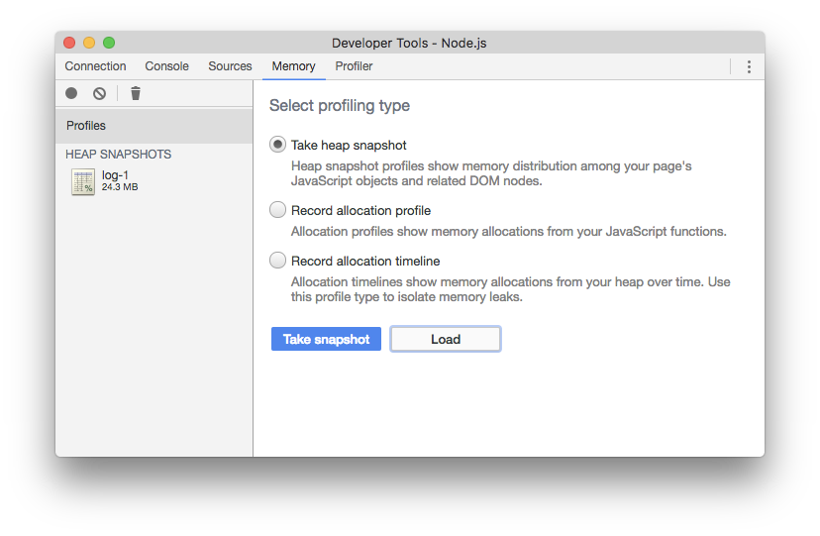
DEMO
Heap Snapshots

Slide 20
Heap Snapshots
Gives you a snapshot with all live JavaScript objects
“This is everything on the heap”
May be large, difficult to sift through. Comparison view is useful.
Detailed tutorial
Attach Chrome DevTools
node --inspect foo.js
DevTools ❯ Memory ❯ "Take heap snapshot"
Production considerations
heapdump module – Generate dumps on demand, or on SIGUSR2
Beware latency spikes. Great for post-mortem debugging.
May contain sensitive data. Share with Care.

Slide 21
Allocation Timeline

Slide 22
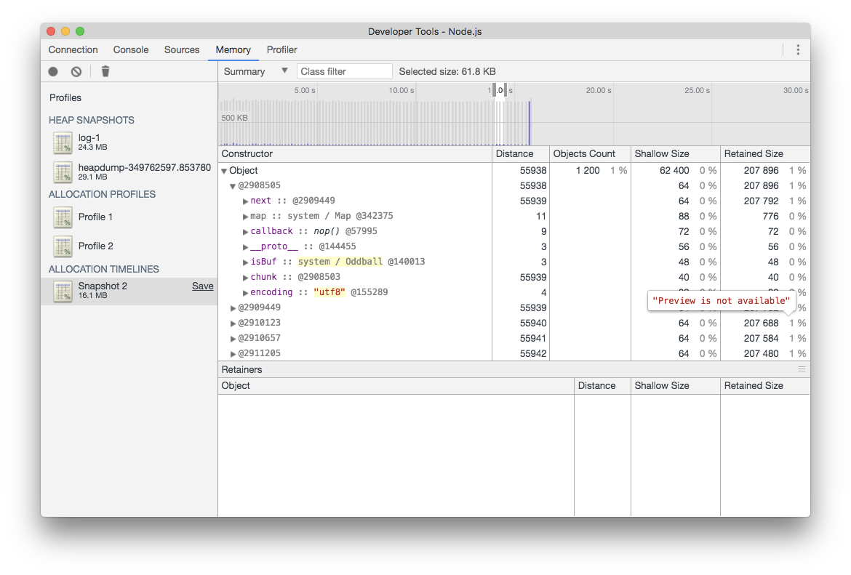
DEMO
Allocation Timeline

Slide 23
Allocation Timeline
Shows you a timeline of object allocations in detail through a sequence of heap snapshots and incremental tracking.
Detailed Tutorial
Very high overhead

Slide 24
Sampling Heap Profiler
New!

Slide 25
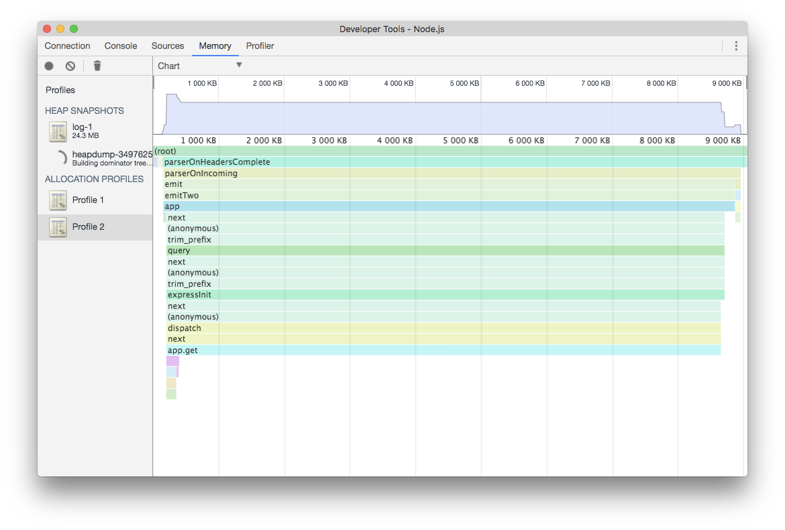
DEMO
Sampling Heap Profiler

Slide 26
Sampling Heap Profiler
New!
Shows you a (representative) sample of JavaScript objects
Works by sampling allocations using a randomized Poisson process (1 sample every 512 KiB on average, customizable)
Keeps track of live sampled objects along with the allocating stacktrace
Low overhead, designed for production
heap-profile module
Caveats:
Allocations from inlined functions get attributed to the calls
Some edge cases might not be observable yet, e.g. V8's Allocation Folding (working on it)

Slide 27
Native Leaks

Slide 28
Native Leaks
Non-JavaScript components can leak memory
Native addons
Node.js core bits written in C++ (example)
V8 (example)
Usually indicated by stable heap, growing RSS
Tools
Isolating native addons
Valgrind: Very useful, but not quite suitable for use in production
tcmalloc and sampling heap profiler
HEAPPROFILE=heapprof LD_PRELOAD=/path/to/libtcmalloc.so node server.js
Use pprof to view profiles

Slide 29
More Resources
These slides: https://goo.gl/Chdxow
Useful Modules & Utilities
memory-usage: plots memory usage over time.
New built-in inspector module (8.x+): JavaScript API for V8 inspector
heapdump: heap snapshots
heap-profile: sampling heap profiles
Low level memory debugging using llnode and mdb
More reading
Making sense of memory and GC terminology: article
Debugging Node.js in Prod at Netflix

Slide 30
Leaks happen.

Slide 31
Try the tools today.

Slide 32
Be prepared :)

Slide 33
class Log extends Writable {
// ...
_write(chunk, encoding, callback) {
// Queue the entries for a bit before doing IO.
this.queue.push(JSON.stringify(chunk));
this.numQueued++;
// If the queue is getting big, drain it.
if (this.numQueued >= QUEUE_BEFORE_DRAIN) {
// Actual file IO omitted for brevity.
this.queue = [];
this.numQueued = 0;
}
}
}
const app = require('express')();
const log = new Log('logfile.txt');
app.get('/', (req, res) => {
log.write(req.url);
res.status(200).send('hello world');
});
app.listen(8080);
// Full example here.
Exercise for the reader

